Slide 1
Rational Agents
Read the AIMA textbook Chapter 2 "Intelligent Agents" (Sections 2.1-2.4). Complete the Quiz on Canvas.
Notes:
One way we might approach designing an artificially intelligent is to build agents that act rationally. Before doing so, we must answer the questions, “What is a rational agent?” And “What does it mean to act rationally?”
These are questions addressed by disciplines like economics or philosophy. We will review several ways of defining rational behavior through the lens of these different disciplines and how they relate to the definition for rational agents that we use for AI artificial intelligence.

Slide 2
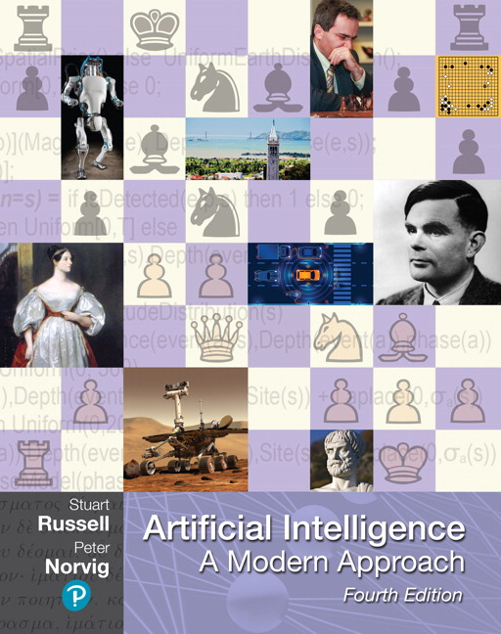
Outline for today’s lecture
Intelligent Agents (AIMA 2.1-2.4)
Task Environments
Formulating Search Problems
Uninformed Search (AIMA 3.1-3.4)

Slide 3
Four views of Artificial Intelligence
This course is about effective programming techniques for designing rational agents
Thinking humanly | Thinking rationally
Acting humanly | Acting rationally
Notes:
Recall that there are several different views on what we might consider artificial intelligence. We discussed agents that could think like humans or act like humans, or think rationally or act rationally.
In this course, we're going to focus on the notion of acting rationally. The overarching theme of the class will be how we can write effective programs and efficient algorithms that will allow us to design rational agents.
Let’s decompose the phrase ‘rational agent’ into its two pieces. We’ll first define what we mean by an agent. And then we’ll define what it means to be rational.

Slide 4
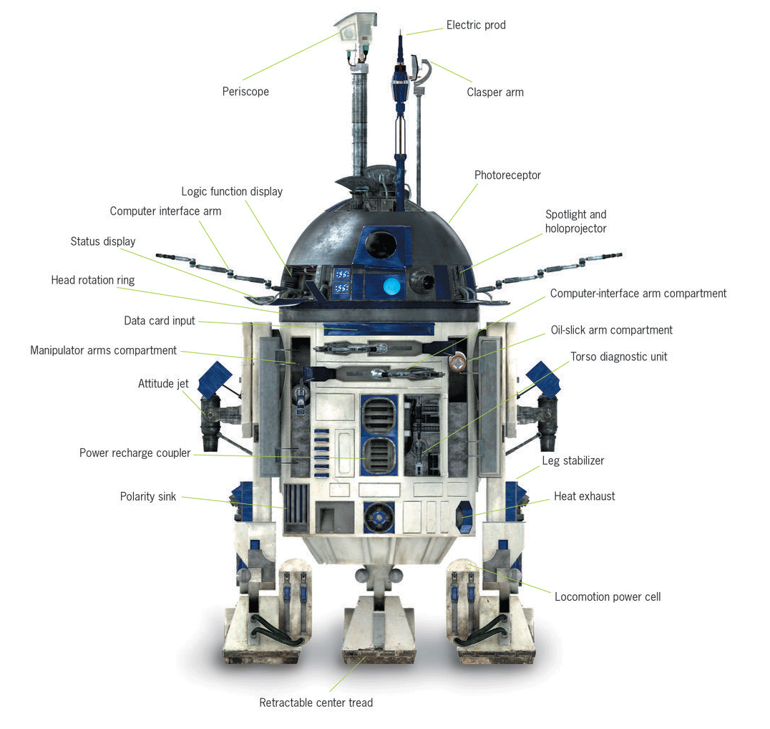
Agents
An agent is anything that perceives its environment through sensors and can act on its environment through actuators
A percept is the agent’s perceptual inputs at any given instance.
Notes:
An agent is defined as anything that can perceive its environment and act on it.
The parts of an agent that are used to perceive the environment are called its sensors.
The parts of the agent that allow it to act on the environment are called its actuators.
The signal that it receives from its sensors is a percent.
A percept will represent an agent’s perception for an instant in time. It could be represented as vector of all of the inputs that the agent is receiving through its sensors.

Slide 5
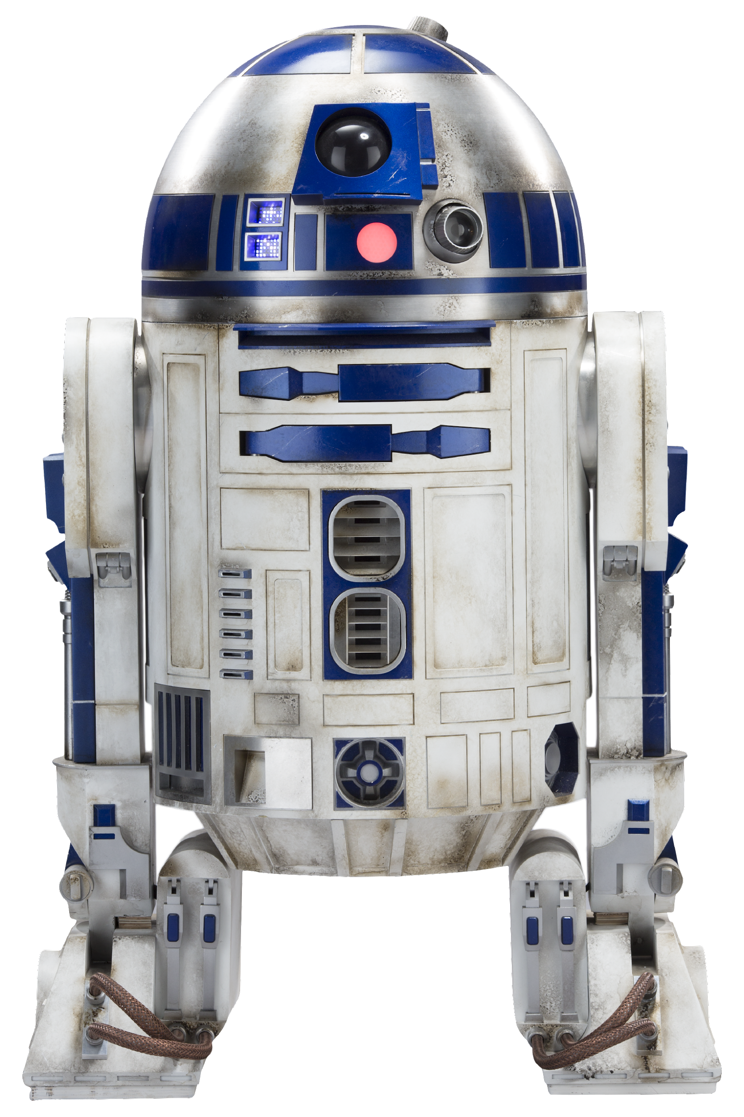
What about your robot?
What actuators does it have?
What sensors does it have?

Slide 6
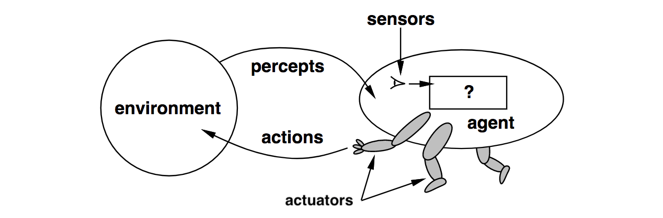
Agents and environments
An agent is specified by an agent function f:P→ a that maps a sequence of percept vectors P to an action a from a set A:
P=[p₀, p₁, … , p_{t}]
A={a₀, a₁, … , a_{k}}
abstract mathematical description
Notes:
In addition to thinking about actuators and sensors, we can think about the relationship between the agent and the environment.
In fact, define a mathematical representation of what the agent and the environment look like.
For the various topics in this class, we will give different formal definitions of the elements of the problem space. For example, we will define what inputs and outputs the agent has access to, what the set of actions are that the agents can take
Our model of the environment will change over the course of the course as well, to incorporate important concepts like whether it is fully observable or not, and whether it behaves in a deterministic or stochastic way.
For now, we can create a mathematical abstraction that is as broad as possible.
We can say that an agent is specified by a function, called an agent function, that takes in as input a sequence of perceptions –remember that's the time slice vector of all the sensor data that the agent is receiving– and then maps that sequence on to a sequence of actions.
The actions are going to be drawn from a set of possible actions that the robot could do via its actuators. For example, the actions could be something like increase the speed of the rotation of the wheels or turn on a light or make a sound. The actual set of actions is going to depend on the actuators that the agent has.

Slide 7
Agent function & program
The agent program runs on the physical architecture to produce f
agent = architecture + program
“Easy” solution: a giant table that maps every possible sequence P to an action a
One problem: exponential in length of P
Notes:
We will make a distinction between this mathematical abstraction of the agent function,
and the program that we write to implement that agent function. The agent program will be a concrete implementation, running within some physical system
An agent function can be implemented using all sorts of programs. It could be a sophisticated program that incorporates the algorithms that will learn about later in the course.
There's inherent about an agent function that requires that it be particularly sophisticated algorithmically. All it has to do is produce an action given a particular percept.
The simplest solution could be a lookup table that associates every possible percept sequence with the best action to take given that sequence.
Of course that simple kind of agent program may be infeasible, since we're talking about sequences. If they were unbounded length or if there were an exponential number of possible combinations of precepts, then our lookup table may simply be too large. It might too difficult to explicitly enumerate the best action for every input sequence.
Instead of using simple table lookups, we are going to start developing more sophisticated algorithms for picking the best action.

Slide 8
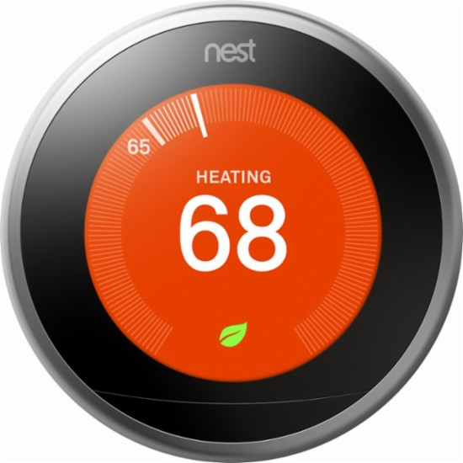
Agents
An agent is anything that can be viewed as
perceiving its environment through sensors and
acting upon that environment through actuators
Human agent:
Sensors: eyes, ears, ...
Actuators: hands, legs, mouth, …
Robotic agent:
Sensors: cameras and infrared range finders
Actuators: various motors
The definition of agents is broad enough to include you and other humans, your pet hampster, robots, softbots, thermostats, …
Notes:
Note that the definition of agent is quite broad.
An agent is anything that can be viewed as perceiving the environment using it sensors and acting upon that environment through actuators.
The definition of agent is very generic. It includes anything that can perceive the environment through sensors and act on it through actuators. Agents can include a huge range of things.
It could be a physical thing like a robot. It could be a software thing like an intelligent agent that monitors the stock market taking input from a stream of data from Yahoo Finance and then operates on the environment by making a trade. That is an intelligent agent, even though it's completely non physical, and the environment that it operates is not a physical environment. It can still perceive and act on it.
Humans also satisfy the definition of agents. You can think of our senses as our sensors like our vision, our hearing, and our sense of touch. Our actuators could be the things that we can use to manipulate the environment around us, our arms or legs and our fingers and our mouths, our voices.
Our definition of agents could even be satisfied by a thermostat. It perceives the temperature in the room with its sensors, and then acts to alter it if it falls beneath a threshold value, by adjusting the boiler to increase the temperature in the radiators. And then once it senses that the temperature has exceeded the threshold then it acts to turn off the boiler again.
That's the working definition that will be used for an agent.

Slide 9




Acting rationally
Rational behavior: doing the right thing
The right thing: that which is expected to maximize goal achievement, given the available information
Rational agent: An agent is an entity that perceives and acts rationally
This course is about effective programming techniques for designing rational agents

Slide 10
Rational Behavior
Notes:
What we really care about is not just building any agents, but building rational agents
So let’s start out by asking, what do we mean by rational? We will start with one definition and iteratively refine it until we get to a final definition that we’re satisfied with.
Let's start simple. A rational agent is some sort of agent that perceives the environment and then behaves rationally. Then let’s define rational behavior as doing the right thing, since its obviously better to do the right thing than it is to do the wrong thing.
But that begs the question, what does it mean to do the right thing? How do we define what the right thing is when we're talking about behaving rationally?

Slide 11
Rational Agent
Let’s try to define “rational agent”.
A rational agent is an agent that perceives its environment and and behaves rationally
Rational behavior: doing the right thing
Obviously doing the right thing is better than doing the wrong thing, but what does it mean to do the right thing?
Notes:
What we really care about is not just building any agents, but building rational agents
So let’s start out by asking, what do we mean by rational? We will start with one definition and iteratively refine it until we get to a final definition that we’re satisfied with.
Let's start simple. A rational agent is some sort of agent that perceives the environment and then behaves rationally. Then let’s define rational behavior as doing the right thing, since its obviously better to do the right thing than it is to do the wrong thing.
But that begs the question, what does it mean to do the right thing? How do we define what the right thing is when we're talking about behaving rationally?

Slide 12
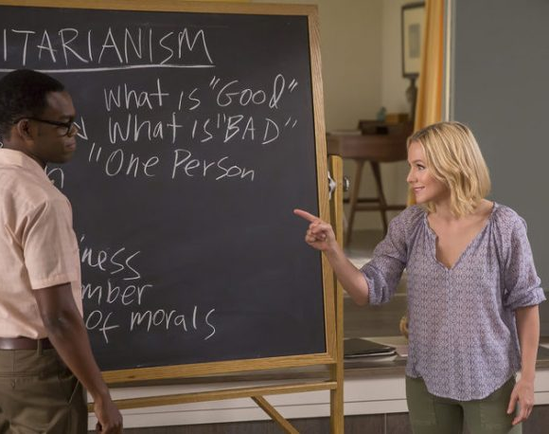
In Philosophy
Moral philosophy has developed different notions of “the right thing”.
AI is usually concerned with Consequentialism.
We evaluate an agent’s behavior by its consequences.
Herbert Simon
The Good Place
Notes:
What does it mean to do the right thing? That's actually a very interesting and complex question.
We could go down the philosophical route. There's this really fun TV show that's all about moral philosophy called The Good Place. The show explicitly addresses how you should behave in order to be a good person, using a range of perspectives from different moral philosophers.
If you're interested in learning about what it means to do the right thing, from a philosophical perspective, then I recommend watching it on Netflix. I binged The Good Place during the pandemic. It’s wonderful – light and thoughtful at the same time.
Moral Philosophy has defined several different notions of what it means to do the right thing, or what the right thing is. Artificial intelligence typically fixates on a philosophical argument called consequentialism.
The idea of consequentialism is that we should evaluate the behavior of an agent or person based on the consequences of the actions that it takes.
When you plop an agent into an environment, then it's going to generate a sequence of actions based on what it pursues. the actions of the agent are going to affect the environment around it. And so what we want to say is, are the effects that the agent has on the environment around it desirable or not.
So we might want to define doing the right thing as, having the agent choose those actions that are going to result in desirable consequences. That's one potential way of starting to refine our definition of what rational behavior means. It could mean doing the things that will have the best consequences.

Slide 13

Is omniscience required?
Notes:
Does consequentialism require omniscience? If we should pick the outcome that will have the best outcome, doesn’t that mean we have to foresee exactly what the outcome of our actions will be? It doesn’t seem possible to know with certainty what the result will be when we commit to an action.
Imagine this situation. You see your friend on the sidewalk, so you stop to say hello. Then a window air conditioning unit falls out of the apartment above you squashes you flat.
Was your decision to stop and say hi to your friend irrational because stopping had a bad consequence? Trying to pick actions that have the good consequences –like living a long healthy life– are clearly desirable, but it's not fair to say that you act irrationally because there's no way that you could have anticipated that outcome in the environment.
What we want to make sure of is that our definition of a rational agent should not require omniscience, right, it should not have to be able to see into the future and see what the outcome of every action will actually be. Rationality can’t require godlike abilities to foresee that if I choose this action, then this will be the ultimate result.

Slide 14
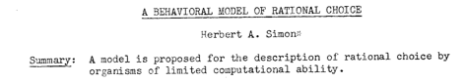

In Economics
Rational choice theory is a framework for understanding social and economic behavior.
The basic premise is that aggregate social behavior results from the behavior of individual actors, each of whom is making their individual decisions.
It assumes that individuals have preferences and choose the alternative that they prefer.
Herbert Simon
Notes:
The field of economics has its own on what constitutes rational behavior. There is a theory called rational choice theory, the incorporates the notion that individuals have bounded rationality. This means that they can only make decisions based on the information available to them, since they cannot be omniscient.
Rational choice theory was developed by Herb Simon. Here is the one sentence summary of his seminal 1953 paper called “a behavioral model of rational choice.” He says,
“In this paper, I propose a model for the description of rational choice by organisms have limited computational ability so organisms for us might be agents.”
Limited computational ability leads to the notion of bounded rationality in economics, and the notion of limited computational ability is very relevant for artificial intelligence as well.
Herb Simon was an economist, a political scientist and a cognitive scientist. Herb Simon, I think, is the only person ever to receive both the Nobel Prize in Economics and the Turing Award.
Alfred Nobel created the Nobel Prize in 1895 he specified that five prizes be given "to those who, during the preceding year, have conferred the greatest benefit to humankind” in the fields of Physics, Chemistry, Medicine, Literature, and Peace .
At the time when the prize was created, computing hadn’t been established yet, so there's no Nobel Prize in computer science. The equivalent is the Turing Award, which
Herbert Simon made won for his contributions to artificial intelligence
Rational choice theory is a framework for understanding economic behavior or even broader societal behavior. The basic idea behind rational choice theory is that the actions of an entire society or a market is a result of behaviors from individuals. And each of those individuals is making their own decisions, where they consider a set of possible alternatives.
The basic assumption behind rational choice theory is that individuals will act in a self interested way, and they will pick the alternative that's most desirable to that person.
That still leaves us something to be defined. If individuals have preferences that allow them to choose the option that they prefer among a set of outcomes. Then we need to have a way to evaluate the utility of some outcome.
We're going to get into a lot of detail of utility functions later in the class. But for now, we're going to start out with a general notion of a performance measure.

Slide 15
Performance measure
How do we know if an agent is acting rationally?
Informally, we expect that it will do the right thing in all circumstances.
How do we know if it’s doing the right thing?
We define a performance measure:
An objective criterion for success of an agent's behavior
given the evidence provided by the percept sequence.
Notes:
How do we know if an agent is acting rationally? Informally, we've said that it should do the right thing. Ideally, if it's rational, it should do the right thing and every circumstance. How do we objectively know whether it did the right thing or not?
Let’s define a performance measure. This will be some objective, measurable criterion of success that evaluates the agent’s behavior.
This means that we will give a score to an agent’s choice to take a particular action based on the consequence of what happens in the environment. We can define this score to relate to what we, as the designers of the system, care about.
This will allow us to say: Given the sequence of actions selected by the agent, did it choose the right action to maximize its performance measure? If so, we’ll say it acted rationally.

Slide 16
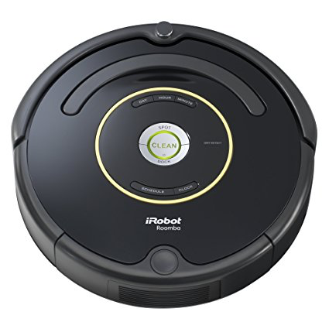
Performance measure examples
Performance measures for a vacuum-cleaner agent might include things like:
+1 point for each clean square at time T
+1 for cleaning a square, -1 for each move
-1000 for more than k dirty squares
Notes:
Here is an example of a performance measure we could talk about for a robotic vacuum.
Let’s say that the agent in question is our Roomba. It has a set of sensors and a set of actuators. We want it to behave rationally, so we should give it a performance measure to try to maximize.
What performance measure could we design for the Roomba? And how would it behave if it acted rationally to try to maximize that performance measure?
So we could devise a performance measure in several different ways.
For instance, we could say that the robot gets +1 point for each clear square at some point in time T, when its clearing routine terminates. So it will try to increase the number of clean squares.
We could also give it +1 point for each time it cleans a square, and -1 point for each move that it makes. That would reduce the amount of unnecessary movement. This would be a great thing to actually incorporate into a Roomba.
My robotic vacuum cleaner tends to have like a random walk through the room. It definitely vacuums the same spot many times, and will often just barely missed some dirty spot that it should have cleaned.
To penalize a robot for missing too many dirty spots, we might also add a threshold that allows us to say if it didn’t clean the room thoroughly enough then failed to do its job. We’ll give it a big penalty like -1000 points.
If the Roomba chooses a set of actions that maximize this performance measure, then we’ll say it has acted rationally. If it does something crazy that results in a very low score, then we’ll say it hasn’t acted rationally.

Slide 17
Rule of thumb for performance measures
It is better to design performance measures according to what you want to be achieved in the environment, rather than how you think the agent should behave.
For example, what might happen if we said
+1 point for each time the robot cleans a square
instead of
+1 point for each clean square at time T
Notes:
Here is a rule of thumb about performance measures that is somewhat surprising: it's better to design a performance measure according to what you want to be achieved, than how you think the agent should behave. Since if you try to dictate how the agent should do its job, rather than what you want accomplished, then it can sometimes cause strange behaviors.
Let's think about an example. So previously we said let's give it a point for each clean square at time T when we tell it to terminate.
What if instead, we gave it +1 for each time it cleaned a square, instead of the total number of cleaned squares at the end. This is a very subtle difference. We’re now not saying what the outcome should be, we’re trying to tell the robot how we think should behave.
This might be a case of being careful what you wish for, because if the robot is trying to act rationally based on this definition, then it tries to maximize this new performance measure (plus one point for every time it cleans the square).
One way that a robot could maximize to clean a square, then dump dirt on it, and clean it again.
This would be unexpected bad behavior, but would maximize the score.
Behaviour of agents can be thought of as being emergent based on how we define our performance measure, so we’ll need to be careful about how we design our performance measures.
When we talk about reinforcement learning we will talk about reward functions. You will see how changing the way that you define your reward function or your performance measure will affect what behavior emerges from the agent.

Slide 18
Rational agents
Rational Agent:
For each possible percept sequence P
a rational agent selects an action a
to maximize its performance measure
Notes:
Now that we have a definition of performance measure, we can start to construct our definition of rational agent.
We will say that a Rational Agent is one that
For each possible percept sequence P
selects an action a
to maximize its performance measure
Clearly this will result in a more desirable sequence of actions, then a selections of actions that leads to a lower score from the performance measure.
But wait! How can the machine know which action will maximize its performance measure?

Slide 19

Rationality is not omniscience
Ideal agent: maximizes actual performance, but needs to be omniscient.
Usually impossible…..
But consider tic-tac-toe agent…
Rationality ≠ Guaranteed Success
Caveat: computational limitations make complete rationality unachievable
design best program for given machine resources
Notes:
Like we said before, we cannot require omniscience for rationality.
Therefore we cannot require maximizing actual performance, since it would have to have a complete understanding of all outcomes. This is going to be impossible most of the time. But in some problems that we consider, like playing simple games like tic-tac-toe, it is actually possible to fully anticipate all possible outcomes, so you can maxmize actual performance.
One interesting caveat is that computational limitations make complete rationality unachievable for most problems, including more sophisticated games like chess or Go. We’ll see later in the course that it’s computationally impossible for a program to consider all possible outcomes for those games.
Therefore, we want to revise our definition of rational agents, to include the fact that computational constraints and uncertainty means that machines cannot be omniscient. They therefore cannot be required to maximize actual performance

Slide 20
Expected value
Rational Agent (initial definition):
For each possible percept sequence P,
a rational agent selects an action a
to maximize its performance measure
Rational Agent (revised definition):
For each possible percept sequence P,
a rational agent selects an action a
that maximizes the expected value of its performance measure
It doesn’t have to know what the actual outcome will be.
Notes:
We’ll modify our definition of a rational agent. We will say that a Rational Agent is one that
For each possible percept sequence P
selects an action a
to maximize the expected value its performance measure
This change means that the agent doesn’t have to know what the actual outcome will be.
This notion of maximizing the expected value is a very powerful concept that will come up again and again and again in the course.
In the next module, we’ll study Minimax and expectimax algorithms, which both maximizing the expected value of outcomes in games. One works when we’re playing against a rational opponent who is trying to maximize its own score in the game, the other works with outcomes that are affected by chance like dice rolls.
We’ll also eventually define the principle of expected maximum utility, which we can use to ensure that we are acting rationally in our own lives.

Slide 21
Task Environments

Slide 22

Task environments
To design a rational agent we need to specify a task environment
a problem specification for which the agent is a solution
PEAS: to specify a task environment
Performance measure
Environment
Actuators
Sensors

Slide 23
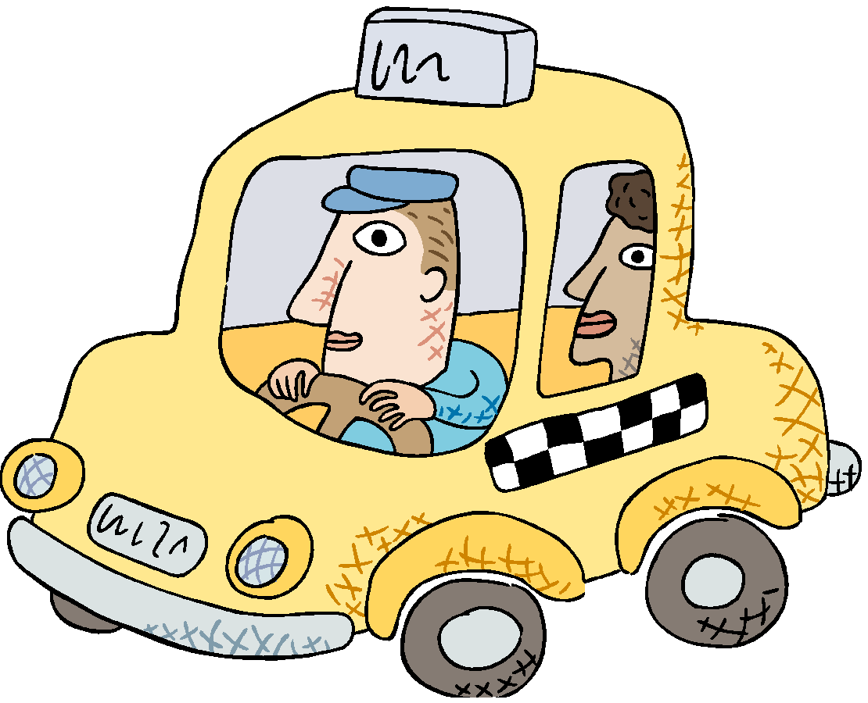
PEAS: Specifying an automated taxi driver
Performance measure:
?
Environment:
?
Actuators:
?
Sensors:
?
Notes:
Performance measure:
safe, fast, legal, comfortable, maximize profits
Environment:
roads, other traffic, pedestrians, customers
Actuators:
steering, accelerator, brake, signal, horn
Sensors:
cameras, sonar, speedometer, GPS

Slide 24
PEAS: Specifying an automated taxi driver
Performance measure:
safe, fast, legal, comfortable, maximize profits
Environment:
roads, other traffic, pedestrians, customers
Actuators:
steering, accelerator, brake, signal, horn
Sensors:
cameras, LiDAR, speedometer, GPS
Notes:
Lidar acronym for light detection and ranging

Slide 25
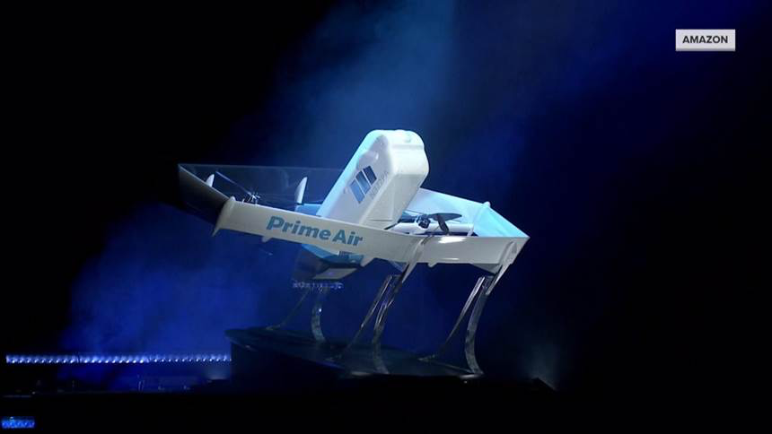
https://www.today.com/video/amazon-adebuts-new-package-delivery-drone-61414981780

Slide 26
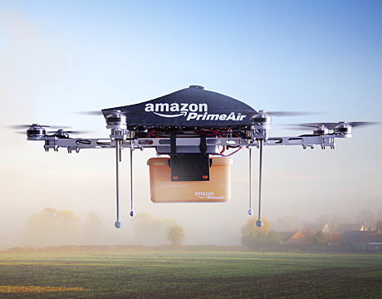
PEAS: Amazon Prime Air
Performance measure:
?
Environment:
?
Actuators:
?
Sensors:
?
Notes:
https://www.mentimeter.com/app/presentation/76e44a7669bd4180935f64b526927a57/8f98eef25cbc/edit https://www.today.com/video/amazon-debuts-new-package-delivery-drone-61414981780
https://nbcnewsencoding-vh.akamaihd.net/i/nbcnews/video/2019/06/tdy_news_costello_amazon_190606_893856774.mp4,,.csmil/master.m3u8?__b__=1000

Slide 27
PEAS: Specifying an Amazon delivery drone
Performance measure:
maximize profits - minimize time - obey laws governing airspace restrictions - deliver package to right location - keep package in good condition - avoid accidents - reduce noise - preserve battery life
Environment:
- airspace - obstacles when airborne (other drones, birds, buildings, trees, utility poles) - obstacles when landing (pets, patio furniture, lawnmowers, people, cars) - weather - distances/route information between warehouse and destinations - position of houses, and spaces that are safe for drop-off- package weight

Slide 28
PEAS: Specifying an Amazon delivery drone
Actuators:
- Propellers and flight control system- Payload actuators: E.g. Arm/basket/claw for picking up, dropping off packages- Lights or signals - Mechanism to announce/verify delivery- Device for delivering packages to customers
Sensors:
GPS - radar/Lidar- altitude sensor- weather sensors (barometer, etc). - gyroscope- accelerometer- camera- rotor sensors- weight sensor to recognize package

Slide 29
The rational agent designer’s goal
abstract mathematical description
Goal of AI practitioner who designs rational agents:
given a PEAS task environment,
Construct agent function f that maximizes the expected value of the performance measure,
Design an agent program that implements f on a particular architecture
concrete implementation
Notes:
The agent function is an abstract mathematical description;
The agent program is a concrete implementation, running within some physical system.

Slide 30
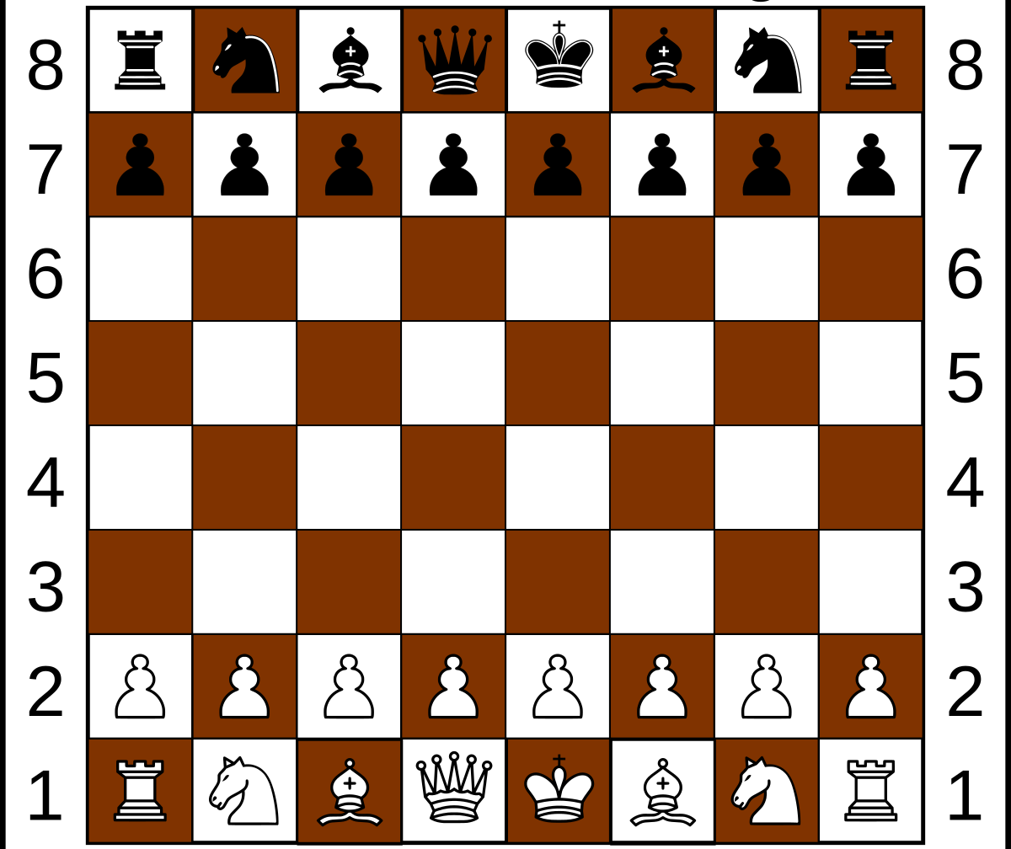
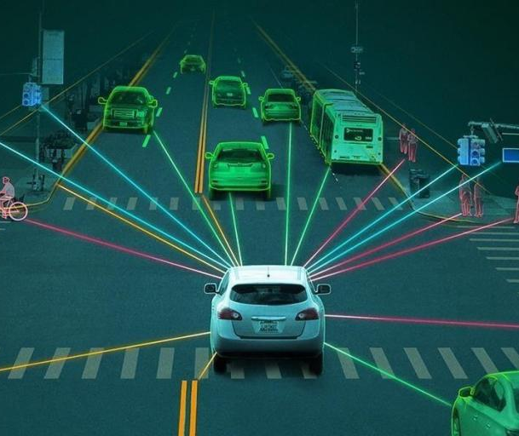
Fully Observable v. Partially Observable

Slide 31
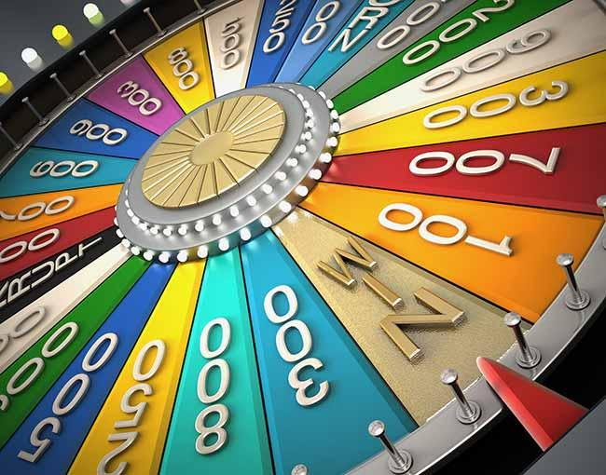
Deterministic v. Nondeterministic v. Stochastic
Notes:
Deterministic (vs. stochastic): The next state of the environment is completely determined by the current state and the action executed by the agent.
If the environment is deterministic except for the actions of other agents, then the environment is strategic.

Slide 32
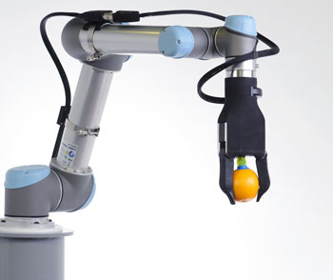
Episodic v. Sequential
Notes:
The agent's experience is divided into atomic "episodes" during which the agent perceives and then performs a single action, and the choice of action in each episode does not depend on any previous action.
In sequential environments, the current decision could affect all future decisions

Slide 33
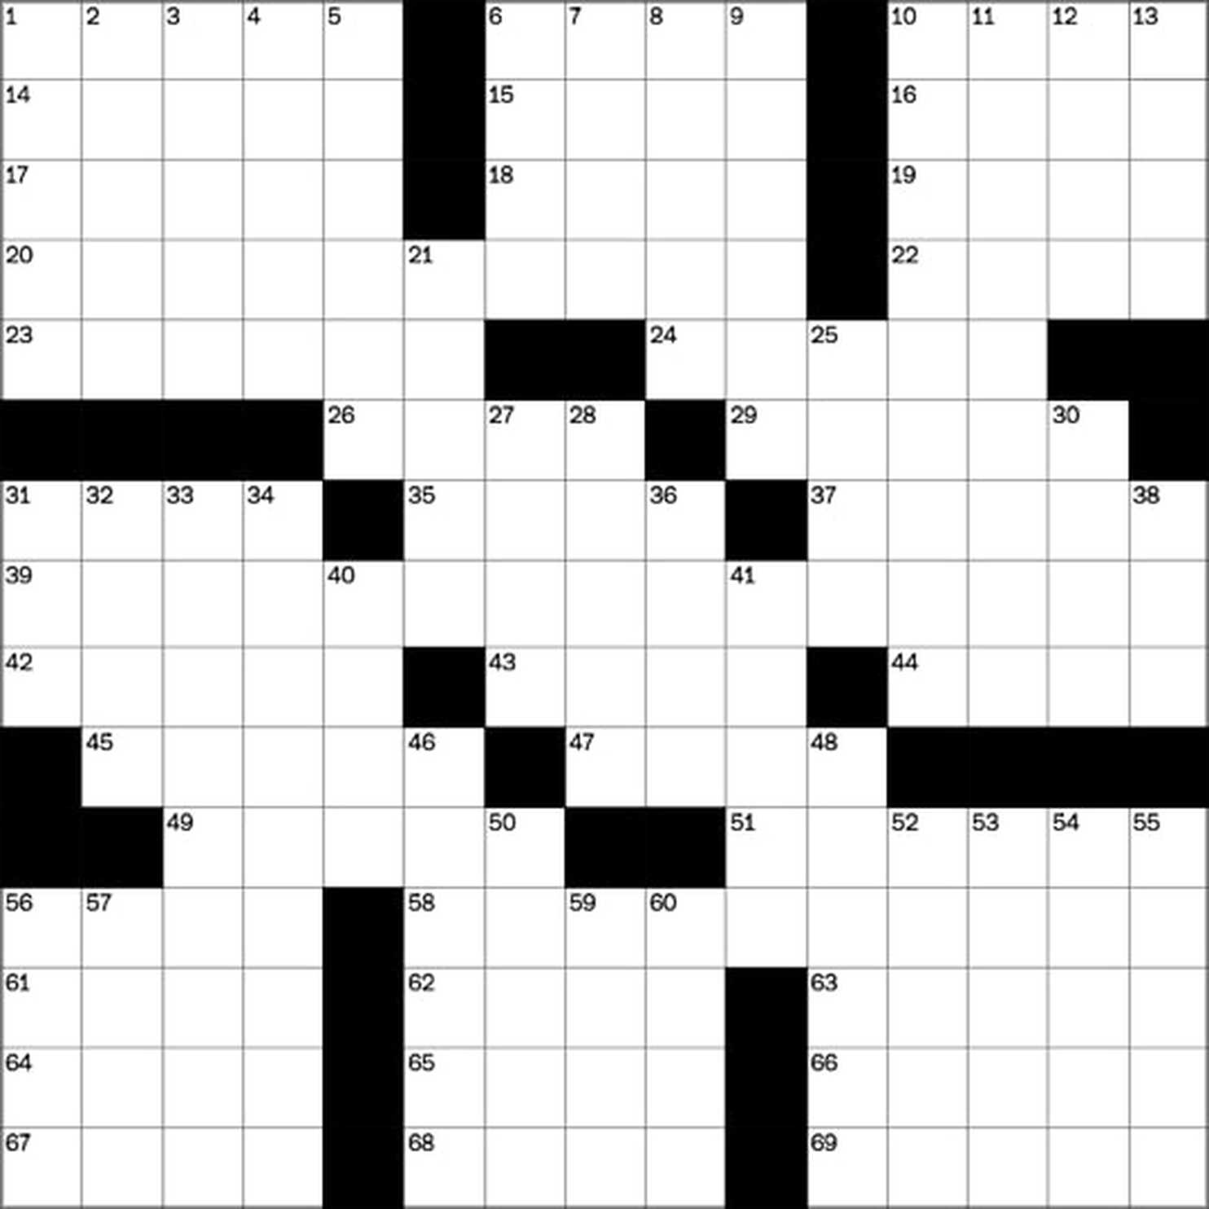
Static v. Dynamic
Notes:
Static (vs. dynamic): The environment is unchanged while an agent is deliberating.
The environment is semidynamic if the environment itself does not change with the passage of time but the agent's performance score does. Chess with a clock is semidynamic.

Slide 34
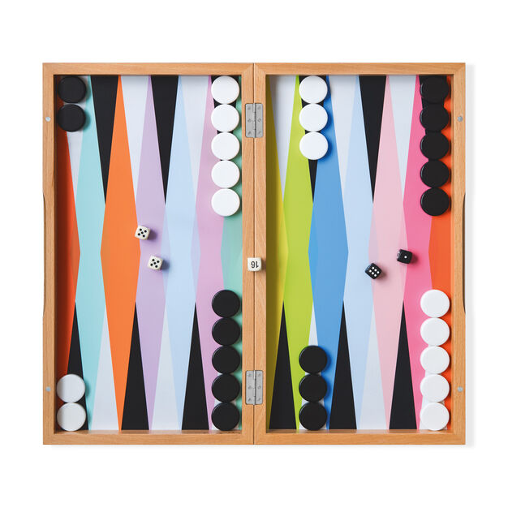
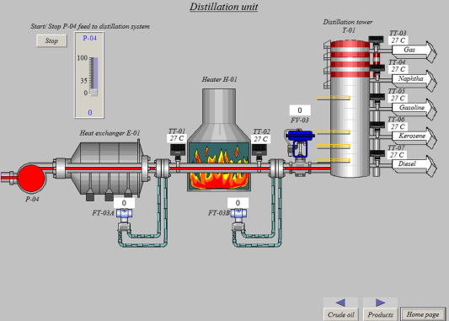
Discrete v. Continuous
Notes:
Discrete (vs. continuous): A limited number of distinct, clearly defined percepts and actions.

Slide 35
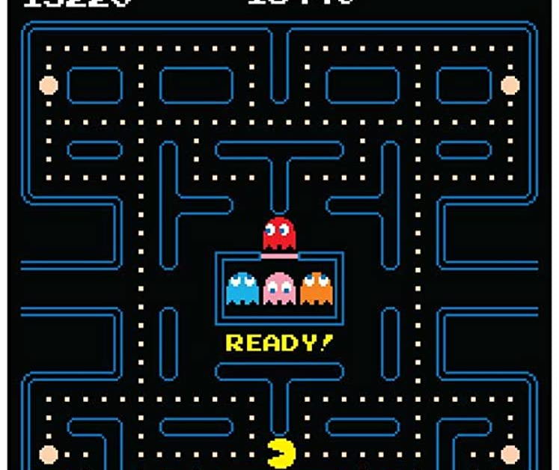
Single Agent v. Multi Agent
Notes:
Multi-agent: Does agent A (the taxi driver) need to treat object B (another vehicle) as an agent, or can it merely be treated as an object behaving according to the laws of physics? Is B’s behavior best described as maximizing a performance measure? Does that also depend on agent A’s behavior? Is it competitive or cooperative?
CCB – write the next slide on the board

Slide 36
When should something be considered an agent?
When should something be considered another agent?
If we’re talking about a self driving taxi, when should we consider something part of the environment versus another agent?
For instance, a telephone pole is part of the environment, but a car might be another agent.
When something behavior can best be described as having its own performance measure, then we should consider it to be an agent.

Slide 37
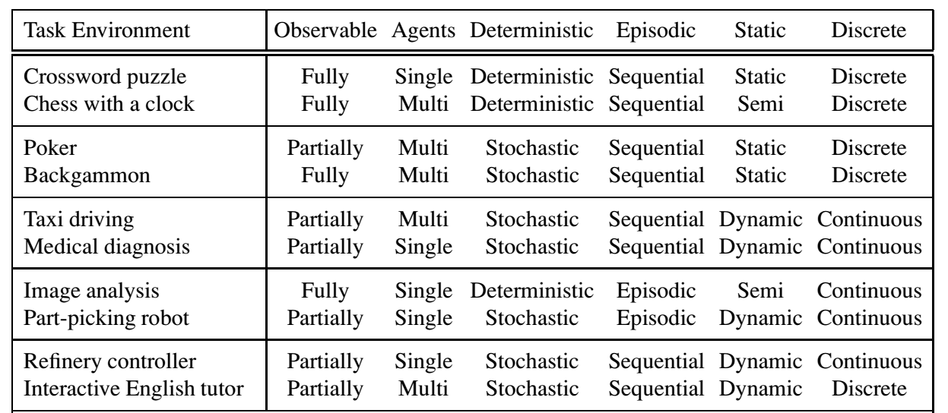
Examples
TASK ENVIRONMENT | OBSERVABLE | AGENTS | DETERMINISTIC | EPISODIC | STATIC | DISCRETE
Crossword puzzle | Fully | Single | Deterministic | Sequential | Static | Discrete
Chess with a clock | Fully | Multi | Deterministic | Sequential | Semi | Discrete
Poker | Partially | Multi | Stochastic | Sequential | Static | Discrete
Backgammon | Fully | Multi | Stochastic | Sequential | Static | Discrete
Taxi driving | Partially | Multi | Stochastic | Sequential | Dynamic | Continuous
Medical diagnosis | Partially | Single | Stochastic | Sequential | Dynamic | Continuous
Image analysis | Fully | Single | Deterministic | Episodic | Semi | Continuous
Part-picking robot | Partially | Single | Stochastic | Episodic | Dynamic | Continuous
Refinery controller | Partially | Single | Stochastic | Sequential | Dynamic | Continuous
Interactive English tutor | Partially | Multi | Stochastic | Sequential | Dynamic | Discrete

Slide 38
The Hardest Environment
Continuous
Partially Observable
Stochastic
Continuous
Multiagent
Unknown Outcomes
The hardest case is:
CONTINUOUS
PARTIALLY OBSERVABLE
STOCHASTIC
MULTIAGENT
UNKNOWN OUTCOMES

Slide 39
Environment Restrictions for Now
We will assume environment is:
STATIC
We will assume environment is
Static
Fully Observable
Deterministic
Discrete
FULLY OBSERVABLE
DETERMINISTIC
DISCRETE

Slide 40
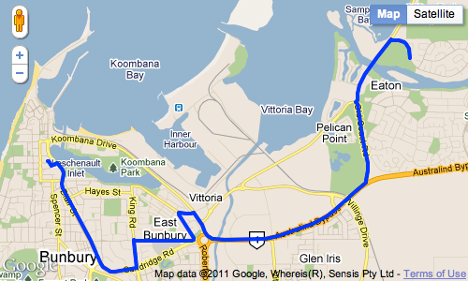
Reflex agents v. Problem solving agents
A simple reflex agent is one that selects an action based on the current percept, and ignores the rest of the percept history.
A problem-solving agent must plan ahead. It will consider a sequence of actions that form a path to a goal state. The computational process that it undertakes is called search.

Slide 41
Problem Solving Agents & Problem Formulation
AIMA 3.1-3.2

Slide 42
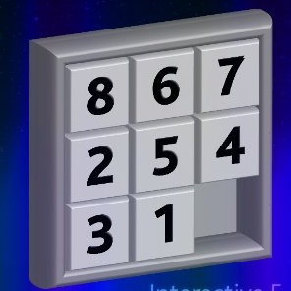

Example search problem: 8-puzzle
Formulate goal
Pieces to end up in order as shown…
Formulate search problem
States: configurations of the puzzle (9! configurations)
Actions: Move one of the movable pieces (≤4 possible)
Performance measure: minimize total moves
Find solution
Sequence of pieces moved: 3,1,6,3,1,…
Notes:
Sometimes a performance measure can be formulated in whether an agent satisfies a goal.
This Is called a sliding block puzzle. This instance is an 8-puzzle.
9!/2 = 181k
Family of sliding block puzzles are NP complete. 15 block puzzle (4x4 board has 1.3 trillion states (1.3*10^12).
5x5 board has 10^25 states.

Slide 43

Copyright 2022 University of Pennsylvania No reproduction or distribution without permission.

